Slide 1

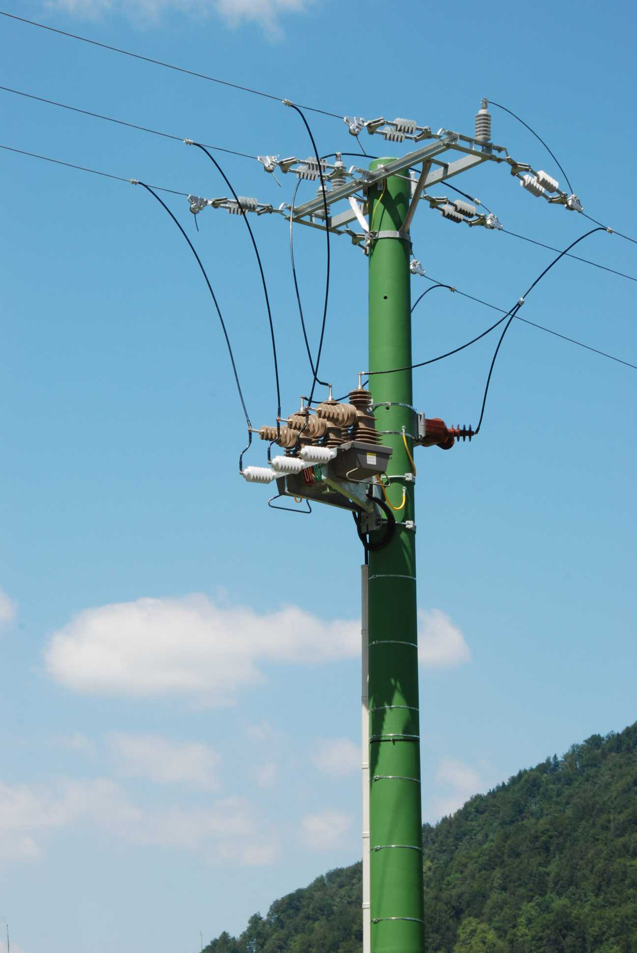
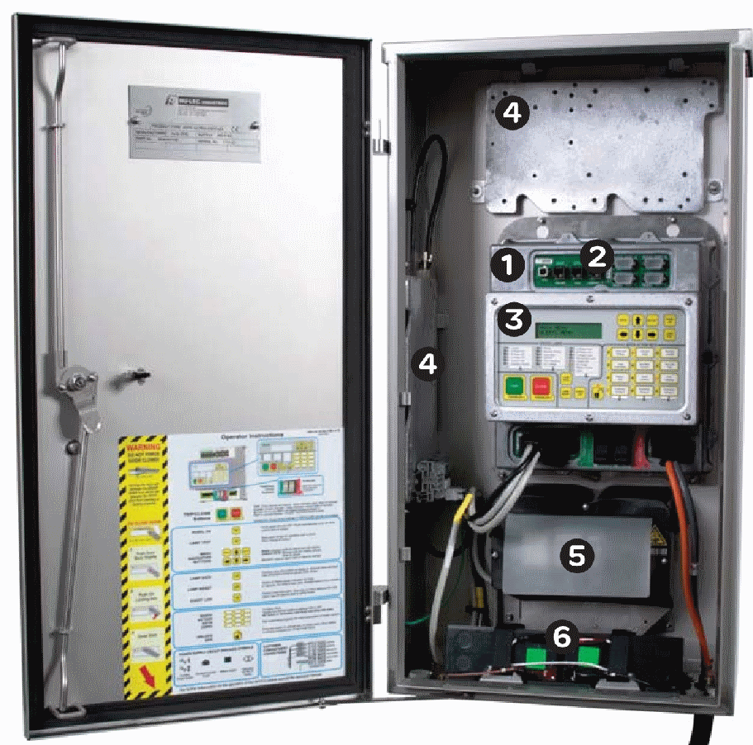

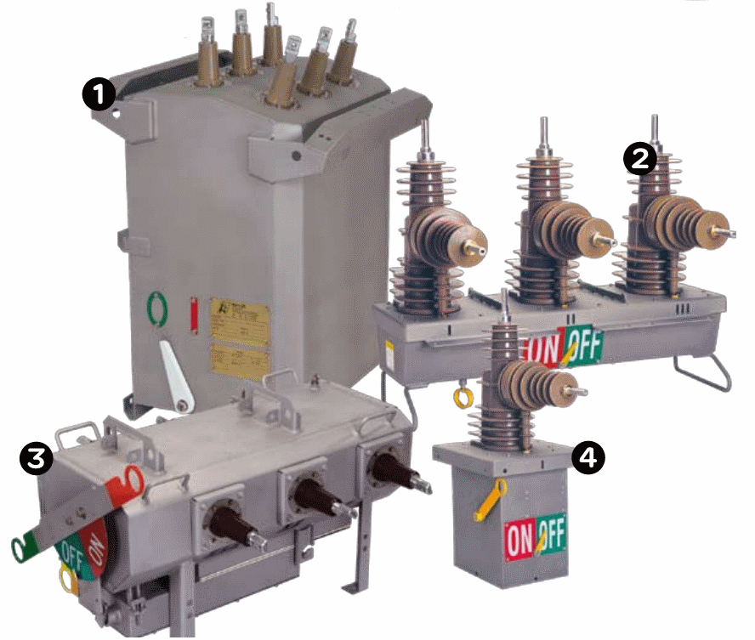


Dobrodošli!
Darko Lestan
Direktor

Slide 2



Dobrodošli!
Welkom!
Telemetry & Remote SCADA Solutions
Darko Lestan
Direktor
Darko Lestan
Stefan Kramer
Stefan Kramer
Regional Sales Manager

Slide 3




1985
1990
1995
ISDN

Slide 4
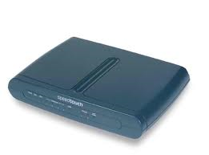

2000
2005
2011
FTTH
xDSL
Docsis
Notes:
Transition effect for timeline, slide 3
(Basic)
Tip: This transition works well for graphics that horizontally span more than one slide.
To reproduce the shape effects on this slide, do the following:
On the Home tab, in the Slides group, click Layout, and then click Blank.
On the Home tab, in the Drawing group, click Shapes, and then under Block Arrows, click Chevron (second row, eighth option from the left). On the slide, drag to draw a long, horizontal chevron shape.
Select the chevron. Under Drawing Tools, on the Format tab, in the Size group, do the following:
In the Shape Height box, enter 0.7”.
In the Shape Width box, enter 9.48”.
Drag the chevron so that the left end is beyond the left edge of the slide, and the right end is approximately one inch left of the right edge of the slide.
Select the chevron. Under Drawing Tools, on the Format tab, in the Shape Styles group, click the arrow next to Shape Fill, click Gradient, and then click More Gradients. In the Format Shape dialog box, click Fill in the left pane, select Gradient fill in the Fill pane, and then do the following:
In the Type list, select Linear.
Click the button next to Direction, and then click Linear Up (second row, second option from the left).
Under Gradient stops, click Add or Remove until a total of four gradient stops appear in the drop-down list.
Also under Gradient stops, customize the gradient stops as follows:
Select Stop 1 from the list, and then do the following:
In the Stop position box, enter 0%.
Click the button next to Color, and then under Theme Colors click White, Background 1 (first row, first option from the left).
Select Stop 2 from the list, and then do the following:
In the Stop position box, enter 36%.
Click the button next to Color, click More Colors, and then in the Colors dialog box, on the Custom tab, enter values for Red: 213, Green: 219, Blue: 221.
Select Stop 3 from the list, and then do the following:
In the Stop position box, enter 73%.
Click the button next to Color, click More Colors, and then in the Colors dialog box, on the Custom tab, enter values for Red: 178, Green: 190, Blue: 194.
Select Stop 4 from the list, and then do the following:
In the Stop position box, enter 100%.
Click the button next to Color, click More Colors, and then in the Colors dialog box, on the Custom tab, enter values for Red: 213, Green: 219, Blue: 221.
Also in the Format Shape dialog box, click Line Color in the left pane, and then select No line in the Line Color pane.
Also in the Format Shape dialog box, click Shadow in the left pane. In the Shadow pane, click the button next to Presets, under Outer click Offset Bottom (first row, second option from the left), and then do the following:
In the Transparency box, enter 60%.
In the Size box, enter 100%.
In the Blur box, enter 4 pt.
In the Angle box, enter 90°.
In the Distance box, enter 3 pt.
Also in the Format Shape dialog box, click 3-D Format in the left pane. In the 3-D Format pane, under Bevel, click the button next to Top, and then under Bevel click Circle (first row, first option from the left). Next to Top, in the Width box, enter 4 pt, and in the Height box, enter 4 pt.
On the Insert tab, in the Text group, click Text Box, and then on the slide, drag to draw the text box.
Enter text in the text box, select the text, and then on the Home tab, in the Font group, select Gill Sans MT Cond from the Font list, enter 26 in the Font Size box, click Bold, click the arrow next to Font Color, and then under Theme Colors click White, Background 1, Darker 50% (sixth row, first option from the left).
On the Home tab, in the Paragraph group, click Center to center the text in the text box.
Select the text box. On the Home tab, in the Clipboard group, click the arrow under Paste, and then click Duplicate. Repeat this process to create a total of three text boxes.
Click in each of the two duplicate text boxes, and then edit the text.
Drag the text boxes onto the chevron shape to form a row.
Press CTRL+A to select all the objects on the slide. On the Home tab, in the Drawing group, click Arrange, point to Align, and then do the following:
Click Align to Slide.
Click Align Middle.
Press and hold SHIFT, and then select all three text boxes. On the Home tab, in the Drawing group, click Arrange, point to Align, and then do the following:
Click Align to Slide.
Click Distribute Horizontally.
To reproduce the animation effects on this slide, do the following:
On the Animations tab, in the Transition to This Slide group, click More, and then under Push and Cover click Push Left.
On the Animations tab, in the Transitions to This Slide group, in the Transition Speed list, select Slow.

Slide 5
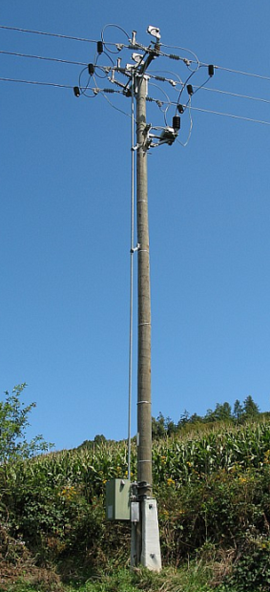



Radio Študent
1985
1990
1995
ISDN

Slide 6
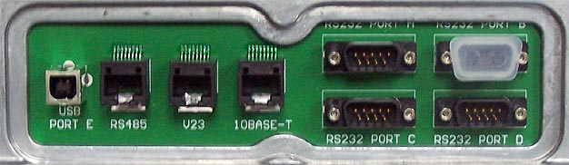


DNP 3.0
IEC 870-5-101
DNP/UDP
IEC 870-5-104
IEC 61850
2000
2005
2011
FTTH
xDSL
Docsis
Notes:
Transition effect for timeline, slide 3
(Basic)
Tip: This transition works well for graphics that horizontally span more than one slide.
To reproduce the shape effects on this slide, do the following:
On the Home tab, in the Slides group, click Layout, and then click Blank.
On the Home tab, in the Drawing group, click Shapes, and then under Block Arrows, click Chevron (second row, eighth option from the left). On the slide, drag to draw a long, horizontal chevron shape.
Select the chevron. Under Drawing Tools, on the Format tab, in the Size group, do the following:
In the Shape Height box, enter 0.7”.
In the Shape Width box, enter 9.48”.
Drag the chevron so that the left end is beyond the left edge of the slide, and the right end is approximately one inch left of the right edge of the slide.
Select the chevron. Under Drawing Tools, on the Format tab, in the Shape Styles group, click the arrow next to Shape Fill, click Gradient, and then click More Gradients. In the Format Shape dialog box, click Fill in the left pane, select Gradient fill in the Fill pane, and then do the following:
In the Type list, select Linear.
Click the button next to Direction, and then click Linear Up (second row, second option from the left).
Under Gradient stops, click Add or Remove until a total of four gradient stops appear in the drop-down list.
Also under Gradient stops, customize the gradient stops as follows:
Select Stop 1 from the list, and then do the following:
In the Stop position box, enter 0%.
Click the button next to Color, and then under Theme Colors click White, Background 1 (first row, first option from the left).
Select Stop 2 from the list, and then do the following:
In the Stop position box, enter 36%.
Click the button next to Color, click More Colors, and then in the Colors dialog box, on the Custom tab, enter values for Red: 213, Green: 219, Blue: 221.
Select Stop 3 from the list, and then do the following:
In the Stop position box, enter 73%.
Click the button next to Color, click More Colors, and then in the Colors dialog box, on the Custom tab, enter values for Red: 178, Green: 190, Blue: 194.
Select Stop 4 from the list, and then do the following:
In the Stop position box, enter 100%.
Click the button next to Color, click More Colors, and then in the Colors dialog box, on the Custom tab, enter values for Red: 213, Green: 219, Blue: 221.
Also in the Format Shape dialog box, click Line Color in the left pane, and then select No line in the Line Color pane.
Also in the Format Shape dialog box, click Shadow in the left pane. In the Shadow pane, click the button next to Presets, under Outer click Offset Bottom (first row, second option from the left), and then do the following:
In the Transparency box, enter 60%.
In the Size box, enter 100%.
In the Blur box, enter 4 pt.
In the Angle box, enter 90°.
In the Distance box, enter 3 pt.
Also in the Format Shape dialog box, click 3-D Format in the left pane. In the 3-D Format pane, under Bevel, click the button next to Top, and then under Bevel click Circle (first row, first option from the left). Next to Top, in the Width box, enter 4 pt, and in the Height box, enter 4 pt.
On the Insert tab, in the Text group, click Text Box, and then on the slide, drag to draw the text box.
Enter text in the text box, select the text, and then on the Home tab, in the Font group, select Gill Sans MT Cond from the Font list, enter 26 in the Font Size box, click Bold, click the arrow next to Font Color, and then under Theme Colors click White, Background 1, Darker 50% (sixth row, first option from the left).
On the Home tab, in the Paragraph group, click Center to center the text in the text box.
Select the text box. On the Home tab, in the Clipboard group, click the arrow under Paste, and then click Duplicate. Repeat this process to create a total of three text boxes.
Click in each of the two duplicate text boxes, and then edit the text.
Drag the text boxes onto the chevron shape to form a row.
Press CTRL+A to select all the objects on the slide. On the Home tab, in the Drawing group, click Arrange, point to Align, and then do the following:
Click Align to Slide.
Click Align Middle.
Press and hold SHIFT, and then select all three text boxes. On the Home tab, in the Drawing group, click Arrange, point to Align, and then do the following:
Click Align to Slide.
Click Distribute Horizontally.
To reproduce the animation effects on this slide, do the following:
On the Animations tab, in the Transition to This Slide group, click More, and then under Push and Cover click Push Left.
On the Animations tab, in the Transitions to This Slide group, in the Transition Speed list, select Slow.

Slide 7




GSM, GPRS, UMTS
DNP, IEC ...
Notes:
Transition effect for timeline, slide 2
(Basic)
Tip: This transition works well for graphics that horizontally span more than one slide.
To reproduce the shape effects on this slide, do the following:
On the Home tab, in the Slides group, click Layout, and then click Blank.
On the Home tab, in the Drawing group, click Shapes, and then under Block Arrows, click Chevron (second row, eighth option from the left). On the slide, drag to draw a long, horizontal chevron shape.
Select the chevron. Under Drawing Tools, on the Format tab, in the Size group, do the following:
In the Shape Height box, enter 0.7”.
In the Shape Width box, enter 11.03”.
Drag the chevron until it extends past both the left and right edges of the slide.
Select the chevron. Under Drawing Tools, on the Format tab, in the Shape Styles group, click the arrow next to Shape Fill, click Gradient, and then click More Gradients.
In the Format Shape dialog box, click Fill in the left pane, select Gradient fill in the Fill pane, and then do the following:
In the Type list, select Linear.
Click the button next to Direction, and then click Linear Up (second row, second option from the left).
Under Gradient stops, click Add or Remove until a total of four gradient stops appear in the drop-down list.
Also under Gradient stops, customize the gradient stops as follows:
Select Stop 1 from the list, and then do the following:
In the Stop position box, enter 0%.
Click the button next to Color, and then under Theme Colors click White, Background 1 (first row, first option from the left).
Select Stop 2 from the list, and then do the following:
In the Stop position box, enter 36%.
Click the button next to Color, click More Colors, and then in the Colors dialog box, on the Custom tab, enter values for Red: 213, Green: 219, Blue: 221.
Select Stop 3 from the list, and then do the following:
In the Stop position box, enter 73%.
Click the button next to Color, click More Colors, and then in the Colors dialog box, on the Custom tab, enter values for Red: 178, Green: 190, Blue: 194.
Select Stop 4 from the list, and then do the following:
In the Stop position box, enter 100%.
Click the button next to Color, click More Colors, and then in the Colors dialog box, on the Custom tab, enter values for Red: 213, Green: 219, Blue: 221.
Also in the Format Shape dialog box, click Line Color in the left pane, and then select No line in the Line Color pane.
Also in the Format Shape dialog box, click Shadow in the left pane. In the Shadow pane, click the button next to Presets, under Outer click Offset Bottom (first row, second option from the left), and then do the following:
In the Transparency box, enter 60%.
In the Size box, enter 100%.
In the Blur box, enter 4 pt.
In the Angle box, enter 90°.
In the Distance box, enter 3 pt.
Also in the Format Shape dialog box, click 3-D Format in the left pane. In the 3-D Format pane, under Bevel, click the button next to Top, and then under Bevel click Circle (first row, first option from the left). Next to Top, in the Width box, enter 4 pt, and in the Height box, enter 4 pt.
On the Insert tab, in the Text group, click Text Box, and then on the slide, drag to draw the text box.
Enter text in the text box, select the text, and then on the Home tab, in the Font group, select Gill Sans MT Cond from the Font list, enter 26 in the Font Size box, click Bold, click the arrow next to Font Color, and then under Theme Colors click White, Background 1, Darker 50% (sixth row, first option from the left).
On the Home tab, in the Paragraph group, click Center to center the text in the text box.
Select the text box. On the Home tab, in the Clipboard group, click the arrow under Paste, and then click Duplicate. Repeat this process to create a total of three text boxes.
Click in each of the two duplicate text boxes, and then edit the text.
Drag the text boxes onto the chevron shape to form a row.
Press CTRL+A to select all the objects on the slide. On the Home tab, in the Drawing group, click Arrange, point to Align, and then do the following:
Click Align to Slide.
Click Align Middle.
Press and hold SHIFT, and then select all three text boxes. On the Home tab, in the Drawing group, click Arrange, point to Align, and then do the following:
Click Align to Slide.
Click Distribute Horizontally.
To reproduce the animation effects on this slide, do the following:
On the Animations tab, in the Transition to This Slide group, click More, and then under Push and Cover click Push Left.
On the Animations tab, in the Transitions to This Slide group, in the Transition Speed list, select Slow.

Slide 8
GSM, GPRS, UMTS
DNP, IEC, MDLC
Notes:
Transition effect for timeline, slide 2
(Basic)
Tip: This transition works well for graphics that horizontally span more than one slide.
To reproduce the shape effects on this slide, do the following:
On the Home tab, in the Slides group, click Layout, and then click Blank.
On the Home tab, in the Drawing group, click Shapes, and then under Block Arrows, click Chevron (second row, eighth option from the left). On the slide, drag to draw a long, horizontal chevron shape.
Select the chevron. Under Drawing Tools, on the Format tab, in the Size group, do the following:
In the Shape Height box, enter 0.7”.
In the Shape Width box, enter 11.03”.
Drag the chevron until it extends past both the left and right edges of the slide.
Select the chevron. Under Drawing Tools, on the Format tab, in the Shape Styles group, click the arrow next to Shape Fill, click Gradient, and then click More Gradients.
In the Format Shape dialog box, click Fill in the left pane, select Gradient fill in the Fill pane, and then do the following:
In the Type list, select Linear.
Click the button next to Direction, and then click Linear Up (second row, second option from the left).
Under Gradient stops, click Add or Remove until a total of four gradient stops appear in the drop-down list.
Also under Gradient stops, customize the gradient stops as follows:
Select Stop 1 from the list, and then do the following:
In the Stop position box, enter 0%.
Click the button next to Color, and then under Theme Colors click White, Background 1 (first row, first option from the left).
Select Stop 2 from the list, and then do the following:
In the Stop position box, enter 36%.
Click the button next to Color, click More Colors, and then in the Colors dialog box, on the Custom tab, enter values for Red: 213, Green: 219, Blue: 221.
Select Stop 3 from the list, and then do the following:
In the Stop position box, enter 73%.
Click the button next to Color, click More Colors, and then in the Colors dialog box, on the Custom tab, enter values for Red: 178, Green: 190, Blue: 194.
Select Stop 4 from the list, and then do the following:
In the Stop position box, enter 100%.
Click the button next to Color, click More Colors, and then in the Colors dialog box, on the Custom tab, enter values for Red: 213, Green: 219, Blue: 221.
Also in the Format Shape dialog box, click Line Color in the left pane, and then select No line in the Line Color pane.
Also in the Format Shape dialog box, click Shadow in the left pane. In the Shadow pane, click the button next to Presets, under Outer click Offset Bottom (first row, second option from the left), and then do the following:
In the Transparency box, enter 60%.
In the Size box, enter 100%.
In the Blur box, enter 4 pt.
In the Angle box, enter 90°.
In the Distance box, enter 3 pt.
Also in the Format Shape dialog box, click 3-D Format in the left pane. In the 3-D Format pane, under Bevel, click the button next to Top, and then under Bevel click Circle (first row, first option from the left). Next to Top, in the Width box, enter 4 pt, and in the Height box, enter 4 pt.
On the Insert tab, in the Text group, click Text Box, and then on the slide, drag to draw the text box.
Enter text in the text box, select the text, and then on the Home tab, in the Font group, select Gill Sans MT Cond from the Font list, enter 26 in the Font Size box, click Bold, click the arrow next to Font Color, and then under Theme Colors click White, Background 1, Darker 50% (sixth row, first option from the left).
On the Home tab, in the Paragraph group, click Center to center the text in the text box.
Select the text box. On the Home tab, in the Clipboard group, click the arrow under Paste, and then click Duplicate. Repeat this process to create a total of three text boxes.
Click in each of the two duplicate text boxes, and then edit the text.
Drag the text boxes onto the chevron shape to form a row.
Press CTRL+A to select all the objects on the slide. On the Home tab, in the Drawing group, click Arrange, point to Align, and then do the following:
Click Align to Slide.
Click Align Middle.
Press and hold SHIFT, and then select all three text boxes. On the Home tab, in the Drawing group, click Arrange, point to Align, and then do the following:
Click Align to Slide.
Click Distribute Horizontally.
To reproduce the animation effects on this slide, do the following:
On the Animations tab, in the Transition to This Slide group, click More, and then under Push and Cover click Push Left.
On the Animations tab, in the Transitions to This Slide group, in the Transition Speed list, select Slow.

Slide 9
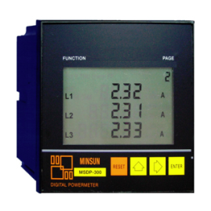
GSM, GPRS, UMTS
DNP, IEC, MDLC, Modbus
Notes:
Transition effect for timeline, slide 2
(Basic)
Tip: This transition works well for graphics that horizontally span more than one slide.
To reproduce the shape effects on this slide, do the following:
On the Home tab, in the Slides group, click Layout, and then click Blank.
On the Home tab, in the Drawing group, click Shapes, and then under Block Arrows, click Chevron (second row, eighth option from the left). On the slide, drag to draw a long, horizontal chevron shape.
Select the chevron. Under Drawing Tools, on the Format tab, in the Size group, do the following:
In the Shape Height box, enter 0.7”.
In the Shape Width box, enter 11.03”.
Drag the chevron until it extends past both the left and right edges of the slide.
Select the chevron. Under Drawing Tools, on the Format tab, in the Shape Styles group, click the arrow next to Shape Fill, click Gradient, and then click More Gradients.
In the Format Shape dialog box, click Fill in the left pane, select Gradient fill in the Fill pane, and then do the following:
In the Type list, select Linear.
Click the button next to Direction, and then click Linear Up (second row, second option from the left).
Under Gradient stops, click Add or Remove until a total of four gradient stops appear in the drop-down list.
Also under Gradient stops, customize the gradient stops as follows:
Select Stop 1 from the list, and then do the following:
In the Stop position box, enter 0%.
Click the button next to Color, and then under Theme Colors click White, Background 1 (first row, first option from the left).
Select Stop 2 from the list, and then do the following:
In the Stop position box, enter 36%.
Click the button next to Color, click More Colors, and then in the Colors dialog box, on the Custom tab, enter values for Red: 213, Green: 219, Blue: 221.
Select Stop 3 from the list, and then do the following:
In the Stop position box, enter 73%.
Click the button next to Color, click More Colors, and then in the Colors dialog box, on the Custom tab, enter values for Red: 178, Green: 190, Blue: 194.
Select Stop 4 from the list, and then do the following:
In the Stop position box, enter 100%.
Click the button next to Color, click More Colors, and then in the Colors dialog box, on the Custom tab, enter values for Red: 213, Green: 219, Blue: 221.
Also in the Format Shape dialog box, click Line Color in the left pane, and then select No line in the Line Color pane.
Also in the Format Shape dialog box, click Shadow in the left pane. In the Shadow pane, click the button next to Presets, under Outer click Offset Bottom (first row, second option from the left), and then do the following:
In the Transparency box, enter 60%.
In the Size box, enter 100%.
In the Blur box, enter 4 pt.
In the Angle box, enter 90°.
In the Distance box, enter 3 pt.
Also in the Format Shape dialog box, click 3-D Format in the left pane. In the 3-D Format pane, under Bevel, click the button next to Top, and then under Bevel click Circle (first row, first option from the left). Next to Top, in the Width box, enter 4 pt, and in the Height box, enter 4 pt.
On the Insert tab, in the Text group, click Text Box, and then on the slide, drag to draw the text box.
Enter text in the text box, select the text, and then on the Home tab, in the Font group, select Gill Sans MT Cond from the Font list, enter 26 in the Font Size box, click Bold, click the arrow next to Font Color, and then under Theme Colors click White, Background 1, Darker 50% (sixth row, first option from the left).
On the Home tab, in the Paragraph group, click Center to center the text in the text box.
Select the text box. On the Home tab, in the Clipboard group, click the arrow under Paste, and then click Duplicate. Repeat this process to create a total of three text boxes.
Click in each of the two duplicate text boxes, and then edit the text.
Drag the text boxes onto the chevron shape to form a row.
Press CTRL+A to select all the objects on the slide. On the Home tab, in the Drawing group, click Arrange, point to Align, and then do the following:
Click Align to Slide.
Click Align Middle.
Press and hold SHIFT, and then select all three text boxes. On the Home tab, in the Drawing group, click Arrange, point to Align, and then do the following:
Click Align to Slide.
Click Distribute Horizontally.
To reproduce the animation effects on this slide, do the following:
On the Animations tab, in the Transition to This Slide group, click More, and then under Push and Cover click Push Left.
On the Animations tab, in the Transitions to This Slide group, in the Transition Speed list, select Slow.

Slide 10


UHF, VHF
MDLC
Notes:
Transition effect for timeline, slide 2
(Basic)
Tip: This transition works well for graphics that horizontally span more than one slide.
To reproduce the shape effects on this slide, do the following:
On the Home tab, in the Slides group, click Layout, and then click Blank.
On the Home tab, in the Drawing group, click Shapes, and then under Block Arrows, click Chevron (second row, eighth option from the left). On the slide, drag to draw a long, horizontal chevron shape.
Select the chevron. Under Drawing Tools, on the Format tab, in the Size group, do the following:
In the Shape Height box, enter 0.7”.
In the Shape Width box, enter 11.03”.
Drag the chevron until it extends past both the left and right edges of the slide.
Select the chevron. Under Drawing Tools, on the Format tab, in the Shape Styles group, click the arrow next to Shape Fill, click Gradient, and then click More Gradients.
In the Format Shape dialog box, click Fill in the left pane, select Gradient fill in the Fill pane, and then do the following:
In the Type list, select Linear.
Click the button next to Direction, and then click Linear Up (second row, second option from the left).
Under Gradient stops, click Add or Remove until a total of four gradient stops appear in the drop-down list.
Also under Gradient stops, customize the gradient stops as follows:
Select Stop 1 from the list, and then do the following:
In the Stop position box, enter 0%.
Click the button next to Color, and then under Theme Colors click White, Background 1 (first row, first option from the left).
Select Stop 2 from the list, and then do the following:
In the Stop position box, enter 36%.
Click the button next to Color, click More Colors, and then in the Colors dialog box, on the Custom tab, enter values for Red: 213, Green: 219, Blue: 221.
Select Stop 3 from the list, and then do the following:
In the Stop position box, enter 73%.
Click the button next to Color, click More Colors, and then in the Colors dialog box, on the Custom tab, enter values for Red: 178, Green: 190, Blue: 194.
Select Stop 4 from the list, and then do the following:
In the Stop position box, enter 100%.
Click the button next to Color, click More Colors, and then in the Colors dialog box, on the Custom tab, enter values for Red: 213, Green: 219, Blue: 221.
Also in the Format Shape dialog box, click Line Color in the left pane, and then select No line in the Line Color pane.
Also in the Format Shape dialog box, click Shadow in the left pane. In the Shadow pane, click the button next to Presets, under Outer click Offset Bottom (first row, second option from the left), and then do the following:
In the Transparency box, enter 60%.
In the Size box, enter 100%.
In the Blur box, enter 4 pt.
In the Angle box, enter 90°.
In the Distance box, enter 3 pt.
Also in the Format Shape dialog box, click 3-D Format in the left pane. In the 3-D Format pane, under Bevel, click the button next to Top, and then under Bevel click Circle (first row, first option from the left). Next to Top, in the Width box, enter 4 pt, and in the Height box, enter 4 pt.
On the Insert tab, in the Text group, click Text Box, and then on the slide, drag to draw the text box.
Enter text in the text box, select the text, and then on the Home tab, in the Font group, select Gill Sans MT Cond from the Font list, enter 26 in the Font Size box, click Bold, click the arrow next to Font Color, and then under Theme Colors click White, Background 1, Darker 50% (sixth row, first option from the left).
On the Home tab, in the Paragraph group, click Center to center the text in the text box.
Select the text box. On the Home tab, in the Clipboard group, click the arrow under Paste, and then click Duplicate. Repeat this process to create a total of three text boxes.
Click in each of the two duplicate text boxes, and then edit the text.
Drag the text boxes onto the chevron shape to form a row.
Press CTRL+A to select all the objects on the slide. On the Home tab, in the Drawing group, click Arrange, point to Align, and then do the following:
Click Align to Slide.
Click Align Middle.
Press and hold SHIFT, and then select all three text boxes. On the Home tab, in the Drawing group, click Arrange, point to Align, and then do the following:
Click Align to Slide.
Click Distribute Horizontally.
To reproduce the animation effects on this slide, do the following:
On the Animations tab, in the Transition to This Slide group, click More, and then under Push and Cover click Push Left.
On the Animations tab, in the Transitions to This Slide group, in the Transition Speed list, select Slow.

Slide 11
UHF, VHF
MDLC
Notes:
Transition effect for timeline, slide 2
(Basic)
Tip: This transition works well for graphics that horizontally span more than one slide.
To reproduce the shape effects on this slide, do the following:
On the Home tab, in the Slides group, click Layout, and then click Blank.
On the Home tab, in the Drawing group, click Shapes, and then under Block Arrows, click Chevron (second row, eighth option from the left). On the slide, drag to draw a long, horizontal chevron shape.
Select the chevron. Under Drawing Tools, on the Format tab, in the Size group, do the following:
In the Shape Height box, enter 0.7”.
In the Shape Width box, enter 11.03”.
Drag the chevron until it extends past both the left and right edges of the slide.
Select the chevron. Under Drawing Tools, on the Format tab, in the Shape Styles group, click the arrow next to Shape Fill, click Gradient, and then click More Gradients.
In the Format Shape dialog box, click Fill in the left pane, select Gradient fill in the Fill pane, and then do the following:
In the Type list, select Linear.
Click the button next to Direction, and then click Linear Up (second row, second option from the left).
Under Gradient stops, click Add or Remove until a total of four gradient stops appear in the drop-down list.
Also under Gradient stops, customize the gradient stops as follows:
Select Stop 1 from the list, and then do the following:
In the Stop position box, enter 0%.
Click the button next to Color, and then under Theme Colors click White, Background 1 (first row, first option from the left).
Select Stop 2 from the list, and then do the following:
In the Stop position box, enter 36%.
Click the button next to Color, click More Colors, and then in the Colors dialog box, on the Custom tab, enter values for Red: 213, Green: 219, Blue: 221.
Select Stop 3 from the list, and then do the following:
In the Stop position box, enter 73%.
Click the button next to Color, click More Colors, and then in the Colors dialog box, on the Custom tab, enter values for Red: 178, Green: 190, Blue: 194.
Select Stop 4 from the list, and then do the following:
In the Stop position box, enter 100%.
Click the button next to Color, click More Colors, and then in the Colors dialog box, on the Custom tab, enter values for Red: 213, Green: 219, Blue: 221.
Also in the Format Shape dialog box, click Line Color in the left pane, and then select No line in the Line Color pane.
Also in the Format Shape dialog box, click Shadow in the left pane. In the Shadow pane, click the button next to Presets, under Outer click Offset Bottom (first row, second option from the left), and then do the following:
In the Transparency box, enter 60%.
In the Size box, enter 100%.
In the Blur box, enter 4 pt.
In the Angle box, enter 90°.
In the Distance box, enter 3 pt.
Also in the Format Shape dialog box, click 3-D Format in the left pane. In the 3-D Format pane, under Bevel, click the button next to Top, and then under Bevel click Circle (first row, first option from the left). Next to Top, in the Width box, enter 4 pt, and in the Height box, enter 4 pt.
On the Insert tab, in the Text group, click Text Box, and then on the slide, drag to draw the text box.
Enter text in the text box, select the text, and then on the Home tab, in the Font group, select Gill Sans MT Cond from the Font list, enter 26 in the Font Size box, click Bold, click the arrow next to Font Color, and then under Theme Colors click White, Background 1, Darker 50% (sixth row, first option from the left).
On the Home tab, in the Paragraph group, click Center to center the text in the text box.
Select the text box. On the Home tab, in the Clipboard group, click the arrow under Paste, and then click Duplicate. Repeat this process to create a total of three text boxes.
Click in each of the two duplicate text boxes, and then edit the text.
Drag the text boxes onto the chevron shape to form a row.
Press CTRL+A to select all the objects on the slide. On the Home tab, in the Drawing group, click Arrange, point to Align, and then do the following:
Click Align to Slide.
Click Align Middle.
Press and hold SHIFT, and then select all three text boxes. On the Home tab, in the Drawing group, click Arrange, point to Align, and then do the following:
Click Align to Slide.
Click Distribute Horizontally.
To reproduce the animation effects on this slide, do the following:
On the Animations tab, in the Transition to This Slide group, click More, and then under Push and Cover click Push Left.
On the Animations tab, in the Transitions to This Slide group, in the Transition Speed list, select Slow.

Slide 12
Notes:
Transition effect for timeline, slide 1
(Basic)
Tip: This transition works well for graphics that horizontally span more than one slide.
To reproduce the shape effects on this slide, do the following:
On the Home tab, in the Slides group, click Layout, and then click Blank.
On the Home tab, in the Drawing group, click Shapes, and then under Block Arrows click Chevron (second row, eighth option from the left). On the slide, drag to draw a long, horizontal chevron shape.
Select the chevron. Under Drawing Tools, on the Format tab, in the Size group, do the following:
In the Shape Height box, enter 0.7”.
In the Shape Width box, enter 9.48”.
Drag the chevron until the right end is beyond the right edge of the slide, and the left end of the chevron is approximately one inch to the right of the left edge of the slide.
Select the chevron. Under Drawing Tools, on the Format tab, in the Shape Styles group, click the arrow next to Shape Fill, point to Gradient, and then click More Gradients. In the Format Shape dialog box, click Fill in the left pane, select Gradient fill in the Fill pane, and then do the following:
In the Type list, select Linear.
Click the button next to Direction, and then click Linear Up (second row, second option from the left).
Under Gradient stops, click Add or Remove until a total of four gradient stops appear in the drop-down list.
Also under Gradient stops, customize the gradient stops as follows:
Select Stop 1 from the list, and then do the following:
In the Stop position box, enter 0%.
Click the button next to Color, and then under Theme Colors click White, Background 1 (first row, first option from the left)
Select Stop 2 from the list, and then do the following:
In the Stop position box, enter 36%.
Click the button next to Color, click More Colors, and then in the Colors dialog box, on the Custom tab, enter values for Red: 213, Green: 219, Blue: 221.
Select Stop 3 from the list, and then do the following:
In the Stop position box, enter 73%.
Click the button next to Color, click More Colors, and then in the Colors dialog box, on the Custom tab, enter values for Red: 178, Green: 190, Blue: 194.
Select Stop 4 from the list, and then do the following:
In the Stop position box, enter 100%.
Click the button next to Color, click More Colors, and then in the Colors dialog box, on the Custom tab, enter values for Red: 213, Green: 219, Blue: 221.
Also in the Format Shape dialog box, click Line Color in the left pane, and then select No line in the Line Color pane.
Also in the Format Shape dialog box, click Shadow in the left pane, and then do the following in the Shadow pane:
Click the button next to Presets, and then under Outer click Offset Bottom (first row, second option from the left).
In the Transparency box, enter 60%.
In the Size box, enter 100%.
In the Blur box, enter 4 pt.
In the Angle box, enter 90°.
In the Distance box, enter 3 pt.
Also in the Format Shape dialog box, click 3-D Format in the left pane. In the 3-D Format pane, under Bevel, click the button next to Top, and then under Bevel click Circle (first row, first option from the left). Next to Top, in the Width box, enter 4 pt, and in the Height box, enter 4 pt.
On the Insert tab, in the Text group, click Text Box, and then on the slide, drag to draw the text box.
Enter text in the text box, select the text, and then on the Home tab, in the Font group, select Gill Sans MT Condensed from the Font list, enter 26 in the Font Size box, click Bold, click the arrow next to Font Color, and then under Theme Colors click White, Background 1, Darker 50% (sixth row, first option from the left).
On the Home tab, in the Paragraph group, click Center to center the text in the text box.
Select the text box. On the Home tab, in the Clipboard group, click the arrow under Paste, and then click Duplicate. Repeat this process to create a total of three text boxes.
Click in each of the two duplicate text boxes, and then edit the text.
Drag the text boxes onto the chevron shape to form a row.
Press CTRL+A to select all the objects on the slide. On the Home tab, in the Drawing group, click Arrange, point to Align, and then do the following:
Click Align to Slide.
Click Align Middle.
Press and hold SHIFT, and then select all three text boxes. On the Home tab, in the Drawing group, click Arrange, point to Align, and then do the following:
Click Align to Slide.
Click Distribute Horizontally.
To reproduce the animation effects on this slide, do the following:
On the Animations tab, in the Transition to This Slide group, click More, and then under Push and Cover click Push Left.
On the Animations tab, in the Transitions to This Slide group, in the Transition Speed list, select Slow.

Slide 13
1. Ste upravitelji (javne) infrastrukture.
2. Zagotavljati morate:
zanesljivost,
razpoložljivost,
varnost,
ekonomičnost obratovanja.
3. Upravljate z geografsko razpršenimi sistemi.
Notes:
Transition effect for timeline, slide 2
(Basic)
Tip: This transition works well for graphics that horizontally span more than one slide.
To reproduce the shape effects on this slide, do the following:
On the Home tab, in the Slides group, click Layout, and then click Blank.
On the Home tab, in the Drawing group, click Shapes, and then under Block Arrows, click Chevron (second row, eighth option from the left). On the slide, drag to draw a long, horizontal chevron shape.
Select the chevron. Under Drawing Tools, on the Format tab, in the Size group, do the following:
In the Shape Height box, enter 0.7”.
In the Shape Width box, enter 11.03”.
Drag the chevron until it extends past both the left and right edges of the slide.
Select the chevron. Under Drawing Tools, on the Format tab, in the Shape Styles group, click the arrow next to Shape Fill, click Gradient, and then click More Gradients.
In the Format Shape dialog box, click Fill in the left pane, select Gradient fill in the Fill pane, and then do the following:
In the Type list, select Linear.
Click the button next to Direction, and then click Linear Up (second row, second option from the left).
Under Gradient stops, click Add or Remove until a total of four gradient stops appear in the drop-down list.
Also under Gradient stops, customize the gradient stops as follows:
Select Stop 1 from the list, and then do the following:
In the Stop position box, enter 0%.
Click the button next to Color, and then under Theme Colors click White, Background 1 (first row, first option from the left).
Select Stop 2 from the list, and then do the following:
In the Stop position box, enter 36%.
Click the button next to Color, click More Colors, and then in the Colors dialog box, on the Custom tab, enter values for Red: 213, Green: 219, Blue: 221.
Select Stop 3 from the list, and then do the following:
In the Stop position box, enter 73%.
Click the button next to Color, click More Colors, and then in the Colors dialog box, on the Custom tab, enter values for Red: 178, Green: 190, Blue: 194.
Select Stop 4 from the list, and then do the following:
In the Stop position box, enter 100%.
Click the button next to Color, click More Colors, and then in the Colors dialog box, on the Custom tab, enter values for Red: 213, Green: 219, Blue: 221.
Also in the Format Shape dialog box, click Line Color in the left pane, and then select No line in the Line Color pane.
Also in the Format Shape dialog box, click Shadow in the left pane. In the Shadow pane, click the button next to Presets, under Outer click Offset Bottom (first row, second option from the left), and then do the following:
In the Transparency box, enter 60%.
In the Size box, enter 100%.
In the Blur box, enter 4 pt.
In the Angle box, enter 90°.
In the Distance box, enter 3 pt.
Also in the Format Shape dialog box, click 3-D Format in the left pane. In the 3-D Format pane, under Bevel, click the button next to Top, and then under Bevel click Circle (first row, first option from the left). Next to Top, in the Width box, enter 4 pt, and in the Height box, enter 4 pt.
On the Insert tab, in the Text group, click Text Box, and then on the slide, drag to draw the text box.
Enter text in the text box, select the text, and then on the Home tab, in the Font group, select Gill Sans MT Cond from the Font list, enter 26 in the Font Size box, click Bold, click the arrow next to Font Color, and then under Theme Colors click White, Background 1, Darker 50% (sixth row, first option from the left).
On the Home tab, in the Paragraph group, click Center to center the text in the text box.
Select the text box. On the Home tab, in the Clipboard group, click the arrow under Paste, and then click Duplicate. Repeat this process to create a total of three text boxes.
Click in each of the two duplicate text boxes, and then edit the text.
Drag the text boxes onto the chevron shape to form a row.
Press CTRL+A to select all the objects on the slide. On the Home tab, in the Drawing group, click Arrange, point to Align, and then do the following:
Click Align to Slide.
Click Align Middle.
Press and hold SHIFT, and then select all three text boxes. On the Home tab, in the Drawing group, click Arrange, point to Align, and then do the following:
Click Align to Slide.
Click Distribute Horizontally.
To reproduce the animation effects on this slide, do the following:
On the Animations tab, in the Transition to This Slide group, click More, and then under Push and Cover click Push Left.
On the Animations tab, in the Transitions to This Slide group, in the Transition Speed list, select Slow.

Slide 14
Digitalizacija!
= mantra
xDSL
Optika (FTTH)
WiMax
GPRS/UMTS
. . . . . . .
Pasovna širina
Cena €/Mbit
Dostop?
Brezžičen!
Kaj pa je za nas res pomembno?

Slide 15
Nas zanima:
doseg!
zanesljivost!
razpoložljivost!
nadzor!
upravljanje!
robustna oprema!
WiMax -> 900MHz -> UHF -> VHF
WiMax -> 900MHz -> UHF -> VHF
WiMax -> 900MHz -> UHF -> VHF
WiMax -> 900MHz -> UHF -> VHF
3 letna garancija
MTBF>2.000.000h
lastni sistem?
(Tetra?)
javni sistem?
lastni sistem?
(Tetra?)
javni sistem?
robustna oprema!
univerzalnost & odprtost!
Izbire je kar nekaj...

Slide 16
UHF, VHF
MDLC
Notes:
Transition effect for timeline, slide 2
(Basic)
Tip: This transition works well for graphics that horizontally span more than one slide.
To reproduce the shape effects on this slide, do the following:
On the Home tab, in the Slides group, click Layout, and then click Blank.
On the Home tab, in the Drawing group, click Shapes, and then under Block Arrows, click Chevron (second row, eighth option from the left). On the slide, drag to draw a long, horizontal chevron shape.
Select the chevron. Under Drawing Tools, on the Format tab, in the Size group, do the following:
In the Shape Height box, enter 0.7”.
In the Shape Width box, enter 11.03”.
Drag the chevron until it extends past both the left and right edges of the slide.
Select the chevron. Under Drawing Tools, on the Format tab, in the Shape Styles group, click the arrow next to Shape Fill, click Gradient, and then click More Gradients.
In the Format Shape dialog box, click Fill in the left pane, select Gradient fill in the Fill pane, and then do the following:
In the Type list, select Linear.
Click the button next to Direction, and then click Linear Up (second row, second option from the left).
Under Gradient stops, click Add or Remove until a total of four gradient stops appear in the drop-down list.
Also under Gradient stops, customize the gradient stops as follows:
Select Stop 1 from the list, and then do the following:
In the Stop position box, enter 0%.
Click the button next to Color, and then under Theme Colors click White, Background 1 (first row, first option from the left).
Select Stop 2 from the list, and then do the following:
In the Stop position box, enter 36%.
Click the button next to Color, click More Colors, and then in the Colors dialog box, on the Custom tab, enter values for Red: 213, Green: 219, Blue: 221.
Select Stop 3 from the list, and then do the following:
In the Stop position box, enter 73%.
Click the button next to Color, click More Colors, and then in the Colors dialog box, on the Custom tab, enter values for Red: 178, Green: 190, Blue: 194.
Select Stop 4 from the list, and then do the following:
In the Stop position box, enter 100%.
Click the button next to Color, click More Colors, and then in the Colors dialog box, on the Custom tab, enter values for Red: 213, Green: 219, Blue: 221.
Also in the Format Shape dialog box, click Line Color in the left pane, and then select No line in the Line Color pane.
Also in the Format Shape dialog box, click Shadow in the left pane. In the Shadow pane, click the button next to Presets, under Outer click Offset Bottom (first row, second option from the left), and then do the following:
In the Transparency box, enter 60%.
In the Size box, enter 100%.
In the Blur box, enter 4 pt.
In the Angle box, enter 90°.
In the Distance box, enter 3 pt.
Also in the Format Shape dialog box, click 3-D Format in the left pane. In the 3-D Format pane, under Bevel, click the button next to Top, and then under Bevel click Circle (first row, first option from the left). Next to Top, in the Width box, enter 4 pt, and in the Height box, enter 4 pt.
On the Insert tab, in the Text group, click Text Box, and then on the slide, drag to draw the text box.
Enter text in the text box, select the text, and then on the Home tab, in the Font group, select Gill Sans MT Cond from the Font list, enter 26 in the Font Size box, click Bold, click the arrow next to Font Color, and then under Theme Colors click White, Background 1, Darker 50% (sixth row, first option from the left).
On the Home tab, in the Paragraph group, click Center to center the text in the text box.
Select the text box. On the Home tab, in the Clipboard group, click the arrow under Paste, and then click Duplicate. Repeat this process to create a total of three text boxes.
Click in each of the two duplicate text boxes, and then edit the text.
Drag the text boxes onto the chevron shape to form a row.
Press CTRL+A to select all the objects on the slide. On the Home tab, in the Drawing group, click Arrange, point to Align, and then do the following:
Click Align to Slide.
Click Align Middle.
Press and hold SHIFT, and then select all three text boxes. On the Home tab, in the Drawing group, click Arrange, point to Align, and then do the following:
Click Align to Slide.
Click Distribute Horizontally.
To reproduce the animation effects on this slide, do the following:
On the Animations tab, in the Transition to This Slide group, click More, and then under Push and Cover click Push Left.
On the Animations tab, in the Transitions to This Slide group, in the Transition Speed list, select Slow.

Slide 17


UHF, VHF
DNP, IEC ...
Notes:
Transition effect for timeline, slide 2
(Basic)
Tip: This transition works well for graphics that horizontally span more than one slide.
To reproduce the shape effects on this slide, do the following:
On the Home tab, in the Slides group, click Layout, and then click Blank.
On the Home tab, in the Drawing group, click Shapes, and then under Block Arrows, click Chevron (second row, eighth option from the left). On the slide, drag to draw a long, horizontal chevron shape.
Select the chevron. Under Drawing Tools, on the Format tab, in the Size group, do the following:
In the Shape Height box, enter 0.7”.
In the Shape Width box, enter 11.03”.
Drag the chevron until it extends past both the left and right edges of the slide.
Select the chevron. Under Drawing Tools, on the Format tab, in the Shape Styles group, click the arrow next to Shape Fill, click Gradient, and then click More Gradients.
In the Format Shape dialog box, click Fill in the left pane, select Gradient fill in the Fill pane, and then do the following:
In the Type list, select Linear.
Click the button next to Direction, and then click Linear Up (second row, second option from the left).
Under Gradient stops, click Add or Remove until a total of four gradient stops appear in the drop-down list.
Also under Gradient stops, customize the gradient stops as follows:
Select Stop 1 from the list, and then do the following:
In the Stop position box, enter 0%.
Click the button next to Color, and then under Theme Colors click White, Background 1 (first row, first option from the left).
Select Stop 2 from the list, and then do the following:
In the Stop position box, enter 36%.
Click the button next to Color, click More Colors, and then in the Colors dialog box, on the Custom tab, enter values for Red: 213, Green: 219, Blue: 221.
Select Stop 3 from the list, and then do the following:
In the Stop position box, enter 73%.
Click the button next to Color, click More Colors, and then in the Colors dialog box, on the Custom tab, enter values for Red: 178, Green: 190, Blue: 194.
Select Stop 4 from the list, and then do the following:
In the Stop position box, enter 100%.
Click the button next to Color, click More Colors, and then in the Colors dialog box, on the Custom tab, enter values for Red: 213, Green: 219, Blue: 221.
Also in the Format Shape dialog box, click Line Color in the left pane, and then select No line in the Line Color pane.
Also in the Format Shape dialog box, click Shadow in the left pane. In the Shadow pane, click the button next to Presets, under Outer click Offset Bottom (first row, second option from the left), and then do the following:
In the Transparency box, enter 60%.
In the Size box, enter 100%.
In the Blur box, enter 4 pt.
In the Angle box, enter 90°.
In the Distance box, enter 3 pt.
Also in the Format Shape dialog box, click 3-D Format in the left pane. In the 3-D Format pane, under Bevel, click the button next to Top, and then under Bevel click Circle (first row, first option from the left). Next to Top, in the Width box, enter 4 pt, and in the Height box, enter 4 pt.
On the Insert tab, in the Text group, click Text Box, and then on the slide, drag to draw the text box.
Enter text in the text box, select the text, and then on the Home tab, in the Font group, select Gill Sans MT Cond from the Font list, enter 26 in the Font Size box, click Bold, click the arrow next to Font Color, and then under Theme Colors click White, Background 1, Darker 50% (sixth row, first option from the left).
On the Home tab, in the Paragraph group, click Center to center the text in the text box.
Select the text box. On the Home tab, in the Clipboard group, click the arrow under Paste, and then click Duplicate. Repeat this process to create a total of three text boxes.
Click in each of the two duplicate text boxes, and then edit the text.
Drag the text boxes onto the chevron shape to form a row.
Press CTRL+A to select all the objects on the slide. On the Home tab, in the Drawing group, click Arrange, point to Align, and then do the following:
Click Align to Slide.
Click Align Middle.
Press and hold SHIFT, and then select all three text boxes. On the Home tab, in the Drawing group, click Arrange, point to Align, and then do the following:
Click Align to Slide.
Click Distribute Horizontally.
To reproduce the animation effects on this slide, do the following:
On the Animations tab, in the Transition to This Slide group, click More, and then under Push and Cover click Push Left.
On the Animations tab, in the Transitions to This Slide group, in the Transition Speed list, select Slow.

Slide 18
UHF, VHF
DNP, IEC, Modbus
Notes:
Transition effect for timeline, slide 2
(Basic)
Tip: This transition works well for graphics that horizontally span more than one slide.
To reproduce the shape effects on this slide, do the following:
On the Home tab, in the Slides group, click Layout, and then click Blank.
On the Home tab, in the Drawing group, click Shapes, and then under Block Arrows, click Chevron (second row, eighth option from the left). On the slide, drag to draw a long, horizontal chevron shape.
Select the chevron. Under Drawing Tools, on the Format tab, in the Size group, do the following:
In the Shape Height box, enter 0.7”.
In the Shape Width box, enter 11.03”.
Drag the chevron until it extends past both the left and right edges of the slide.
Select the chevron. Under Drawing Tools, on the Format tab, in the Shape Styles group, click the arrow next to Shape Fill, click Gradient, and then click More Gradients.
In the Format Shape dialog box, click Fill in the left pane, select Gradient fill in the Fill pane, and then do the following:
In the Type list, select Linear.
Click the button next to Direction, and then click Linear Up (second row, second option from the left).
Under Gradient stops, click Add or Remove until a total of four gradient stops appear in the drop-down list.
Also under Gradient stops, customize the gradient stops as follows:
Select Stop 1 from the list, and then do the following:
In the Stop position box, enter 0%.
Click the button next to Color, and then under Theme Colors click White, Background 1 (first row, first option from the left).
Select Stop 2 from the list, and then do the following:
In the Stop position box, enter 36%.
Click the button next to Color, click More Colors, and then in the Colors dialog box, on the Custom tab, enter values for Red: 213, Green: 219, Blue: 221.
Select Stop 3 from the list, and then do the following:
In the Stop position box, enter 73%.
Click the button next to Color, click More Colors, and then in the Colors dialog box, on the Custom tab, enter values for Red: 178, Green: 190, Blue: 194.
Select Stop 4 from the list, and then do the following:
In the Stop position box, enter 100%.
Click the button next to Color, click More Colors, and then in the Colors dialog box, on the Custom tab, enter values for Red: 213, Green: 219, Blue: 221.
Also in the Format Shape dialog box, click Line Color in the left pane, and then select No line in the Line Color pane.
Also in the Format Shape dialog box, click Shadow in the left pane. In the Shadow pane, click the button next to Presets, under Outer click Offset Bottom (first row, second option from the left), and then do the following:
In the Transparency box, enter 60%.
In the Size box, enter 100%.
In the Blur box, enter 4 pt.
In the Angle box, enter 90°.
In the Distance box, enter 3 pt.
Also in the Format Shape dialog box, click 3-D Format in the left pane. In the 3-D Format pane, under Bevel, click the button next to Top, and then under Bevel click Circle (first row, first option from the left). Next to Top, in the Width box, enter 4 pt, and in the Height box, enter 4 pt.
On the Insert tab, in the Text group, click Text Box, and then on the slide, drag to draw the text box.
Enter text in the text box, select the text, and then on the Home tab, in the Font group, select Gill Sans MT Cond from the Font list, enter 26 in the Font Size box, click Bold, click the arrow next to Font Color, and then under Theme Colors click White, Background 1, Darker 50% (sixth row, first option from the left).
On the Home tab, in the Paragraph group, click Center to center the text in the text box.
Select the text box. On the Home tab, in the Clipboard group, click the arrow under Paste, and then click Duplicate. Repeat this process to create a total of three text boxes.
Click in each of the two duplicate text boxes, and then edit the text.
Drag the text boxes onto the chevron shape to form a row.
Press CTRL+A to select all the objects on the slide. On the Home tab, in the Drawing group, click Arrange, point to Align, and then do the following:
Click Align to Slide.
Click Align Middle.
Press and hold SHIFT, and then select all three text boxes. On the Home tab, in the Drawing group, click Arrange, point to Align, and then do the following:
Click Align to Slide.
Click Distribute Horizontally.
To reproduce the animation effects on this slide, do the following:
On the Animations tab, in the Transition to This Slide group, click More, and then under Push and Cover click Push Left.
On the Animations tab, in the Transitions to This Slide group, in the Transition Speed list, select Slow.

Slide 19
UHF, VHF
DNP, IEC, Modbus
Notes:
Transition effect for timeline, slide 2
(Basic)
Tip: This transition works well for graphics that horizontally span more than one slide.
To reproduce the shape effects on this slide, do the following:
On the Home tab, in the Slides group, click Layout, and then click Blank.
On the Home tab, in the Drawing group, click Shapes, and then under Block Arrows, click Chevron (second row, eighth option from the left). On the slide, drag to draw a long, horizontal chevron shape.
Select the chevron. Under Drawing Tools, on the Format tab, in the Size group, do the following:
In the Shape Height box, enter 0.7”.
In the Shape Width box, enter 11.03”.
Drag the chevron until it extends past both the left and right edges of the slide.
Select the chevron. Under Drawing Tools, on the Format tab, in the Shape Styles group, click the arrow next to Shape Fill, click Gradient, and then click More Gradients.
In the Format Shape dialog box, click Fill in the left pane, select Gradient fill in the Fill pane, and then do the following:
In the Type list, select Linear.
Click the button next to Direction, and then click Linear Up (second row, second option from the left).
Under Gradient stops, click Add or Remove until a total of four gradient stops appear in the drop-down list.
Also under Gradient stops, customize the gradient stops as follows:
Select Stop 1 from the list, and then do the following:
In the Stop position box, enter 0%.
Click the button next to Color, and then under Theme Colors click White, Background 1 (first row, first option from the left).
Select Stop 2 from the list, and then do the following:
In the Stop position box, enter 36%.
Click the button next to Color, click More Colors, and then in the Colors dialog box, on the Custom tab, enter values for Red: 213, Green: 219, Blue: 221.
Select Stop 3 from the list, and then do the following:
In the Stop position box, enter 73%.
Click the button next to Color, click More Colors, and then in the Colors dialog box, on the Custom tab, enter values for Red: 178, Green: 190, Blue: 194.
Select Stop 4 from the list, and then do the following:
In the Stop position box, enter 100%.
Click the button next to Color, click More Colors, and then in the Colors dialog box, on the Custom tab, enter values for Red: 213, Green: 219, Blue: 221.
Also in the Format Shape dialog box, click Line Color in the left pane, and then select No line in the Line Color pane.
Also in the Format Shape dialog box, click Shadow in the left pane. In the Shadow pane, click the button next to Presets, under Outer click Offset Bottom (first row, second option from the left), and then do the following:
In the Transparency box, enter 60%.
In the Size box, enter 100%.
In the Blur box, enter 4 pt.
In the Angle box, enter 90°.
In the Distance box, enter 3 pt.
Also in the Format Shape dialog box, click 3-D Format in the left pane. In the 3-D Format pane, under Bevel, click the button next to Top, and then under Bevel click Circle (first row, first option from the left). Next to Top, in the Width box, enter 4 pt, and in the Height box, enter 4 pt.
On the Insert tab, in the Text group, click Text Box, and then on the slide, drag to draw the text box.
Enter text in the text box, select the text, and then on the Home tab, in the Font group, select Gill Sans MT Cond from the Font list, enter 26 in the Font Size box, click Bold, click the arrow next to Font Color, and then under Theme Colors click White, Background 1, Darker 50% (sixth row, first option from the left).
On the Home tab, in the Paragraph group, click Center to center the text in the text box.
Select the text box. On the Home tab, in the Clipboard group, click the arrow under Paste, and then click Duplicate. Repeat this process to create a total of three text boxes.
Click in each of the two duplicate text boxes, and then edit the text.
Drag the text boxes onto the chevron shape to form a row.
Press CTRL+A to select all the objects on the slide. On the Home tab, in the Drawing group, click Arrange, point to Align, and then do the following:
Click Align to Slide.
Click Align Middle.
Press and hold SHIFT, and then select all three text boxes. On the Home tab, in the Drawing group, click Arrange, point to Align, and then do the following:
Click Align to Slide.
Click Distribute Horizontally.
To reproduce the animation effects on this slide, do the following:
On the Animations tab, in the Transition to This Slide group, click More, and then under Push and Cover click Push Left.
On the Animations tab, in the Transitions to This Slide group, in the Transition Speed list, select Slow.

Slide 20
UHF, VHF
DNP, IEC, MDLC
Notes:
Transition effect for timeline, slide 2
(Basic)
Tip: This transition works well for graphics that horizontally span more than one slide.
To reproduce the shape effects on this slide, do the following:
On the Home tab, in the Slides group, click Layout, and then click Blank.
On the Home tab, in the Drawing group, click Shapes, and then under Block Arrows, click Chevron (second row, eighth option from the left). On the slide, drag to draw a long, horizontal chevron shape.
Select the chevron. Under Drawing Tools, on the Format tab, in the Size group, do the following:
In the Shape Height box, enter 0.7”.
In the Shape Width box, enter 11.03”.
Drag the chevron until it extends past both the left and right edges of the slide.
Select the chevron. Under Drawing Tools, on the Format tab, in the Shape Styles group, click the arrow next to Shape Fill, click Gradient, and then click More Gradients.
In the Format Shape dialog box, click Fill in the left pane, select Gradient fill in the Fill pane, and then do the following:
In the Type list, select Linear.
Click the button next to Direction, and then click Linear Up (second row, second option from the left).
Under Gradient stops, click Add or Remove until a total of four gradient stops appear in the drop-down list.
Also under Gradient stops, customize the gradient stops as follows:
Select Stop 1 from the list, and then do the following:
In the Stop position box, enter 0%.
Click the button next to Color, and then under Theme Colors click White, Background 1 (first row, first option from the left).
Select Stop 2 from the list, and then do the following:
In the Stop position box, enter 36%.
Click the button next to Color, click More Colors, and then in the Colors dialog box, on the Custom tab, enter values for Red: 213, Green: 219, Blue: 221.
Select Stop 3 from the list, and then do the following:
In the Stop position box, enter 73%.
Click the button next to Color, click More Colors, and then in the Colors dialog box, on the Custom tab, enter values for Red: 178, Green: 190, Blue: 194.
Select Stop 4 from the list, and then do the following:
In the Stop position box, enter 100%.
Click the button next to Color, click More Colors, and then in the Colors dialog box, on the Custom tab, enter values for Red: 213, Green: 219, Blue: 221.
Also in the Format Shape dialog box, click Line Color in the left pane, and then select No line in the Line Color pane.
Also in the Format Shape dialog box, click Shadow in the left pane. In the Shadow pane, click the button next to Presets, under Outer click Offset Bottom (first row, second option from the left), and then do the following:
In the Transparency box, enter 60%.
In the Size box, enter 100%.
In the Blur box, enter 4 pt.
In the Angle box, enter 90°.
In the Distance box, enter 3 pt.
Also in the Format Shape dialog box, click 3-D Format in the left pane. In the 3-D Format pane, under Bevel, click the button next to Top, and then under Bevel click Circle (first row, first option from the left). Next to Top, in the Width box, enter 4 pt, and in the Height box, enter 4 pt.
On the Insert tab, in the Text group, click Text Box, and then on the slide, drag to draw the text box.
Enter text in the text box, select the text, and then on the Home tab, in the Font group, select Gill Sans MT Cond from the Font list, enter 26 in the Font Size box, click Bold, click the arrow next to Font Color, and then under Theme Colors click White, Background 1, Darker 50% (sixth row, first option from the left).
On the Home tab, in the Paragraph group, click Center to center the text in the text box.
Select the text box. On the Home tab, in the Clipboard group, click the arrow under Paste, and then click Duplicate. Repeat this process to create a total of three text boxes.
Click in each of the two duplicate text boxes, and then edit the text.
Drag the text boxes onto the chevron shape to form a row.
Press CTRL+A to select all the objects on the slide. On the Home tab, in the Drawing group, click Arrange, point to Align, and then do the following:
Click Align to Slide.
Click Align Middle.
Press and hold SHIFT, and then select all three text boxes. On the Home tab, in the Drawing group, click Arrange, point to Align, and then do the following:
Click Align to Slide.
Click Distribute Horizontally.
To reproduce the animation effects on this slide, do the following:
On the Animations tab, in the Transition to This Slide group, click More, and then under Push and Cover click Push Left.
On the Animations tab, in the Transitions to This Slide group, in the Transition Speed list, select Slow.

Slide 21

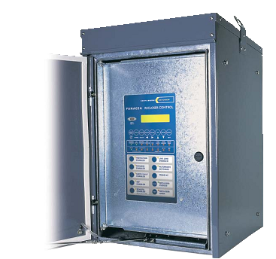
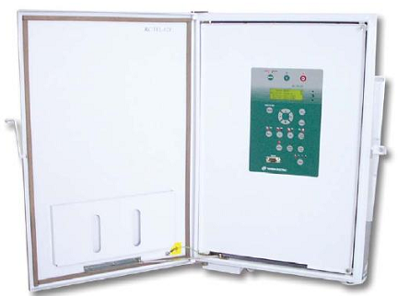
UHF, VHF
DNP, IEC, MDLC
Notes:
Transition effect for timeline, slide 2
(Basic)
Tip: This transition works well for graphics that horizontally span more than one slide.
To reproduce the shape effects on this slide, do the following:
On the Home tab, in the Slides group, click Layout, and then click Blank.
On the Home tab, in the Drawing group, click Shapes, and then under Block Arrows, click Chevron (second row, eighth option from the left). On the slide, drag to draw a long, horizontal chevron shape.
Select the chevron. Under Drawing Tools, on the Format tab, in the Size group, do the following:
In the Shape Height box, enter 0.7”.
In the Shape Width box, enter 11.03”.
Drag the chevron until it extends past both the left and right edges of the slide.
Select the chevron. Under Drawing Tools, on the Format tab, in the Shape Styles group, click the arrow next to Shape Fill, click Gradient, and then click More Gradients.
In the Format Shape dialog box, click Fill in the left pane, select Gradient fill in the Fill pane, and then do the following:
In the Type list, select Linear.
Click the button next to Direction, and then click Linear Up (second row, second option from the left).
Under Gradient stops, click Add or Remove until a total of four gradient stops appear in the drop-down list.
Also under Gradient stops, customize the gradient stops as follows:
Select Stop 1 from the list, and then do the following:
In the Stop position box, enter 0%.
Click the button next to Color, and then under Theme Colors click White, Background 1 (first row, first option from the left).
Select Stop 2 from the list, and then do the following:
In the Stop position box, enter 36%.
Click the button next to Color, click More Colors, and then in the Colors dialog box, on the Custom tab, enter values for Red: 213, Green: 219, Blue: 221.
Select Stop 3 from the list, and then do the following:
In the Stop position box, enter 73%.
Click the button next to Color, click More Colors, and then in the Colors dialog box, on the Custom tab, enter values for Red: 178, Green: 190, Blue: 194.
Select Stop 4 from the list, and then do the following:
In the Stop position box, enter 100%.
Click the button next to Color, click More Colors, and then in the Colors dialog box, on the Custom tab, enter values for Red: 213, Green: 219, Blue: 221.
Also in the Format Shape dialog box, click Line Color in the left pane, and then select No line in the Line Color pane.
Also in the Format Shape dialog box, click Shadow in the left pane. In the Shadow pane, click the button next to Presets, under Outer click Offset Bottom (first row, second option from the left), and then do the following:
In the Transparency box, enter 60%.
In the Size box, enter 100%.
In the Blur box, enter 4 pt.
In the Angle box, enter 90°.
In the Distance box, enter 3 pt.
Also in the Format Shape dialog box, click 3-D Format in the left pane. In the 3-D Format pane, under Bevel, click the button next to Top, and then under Bevel click Circle (first row, first option from the left). Next to Top, in the Width box, enter 4 pt, and in the Height box, enter 4 pt.
On the Insert tab, in the Text group, click Text Box, and then on the slide, drag to draw the text box.
Enter text in the text box, select the text, and then on the Home tab, in the Font group, select Gill Sans MT Cond from the Font list, enter 26 in the Font Size box, click Bold, click the arrow next to Font Color, and then under Theme Colors click White, Background 1, Darker 50% (sixth row, first option from the left).
On the Home tab, in the Paragraph group, click Center to center the text in the text box.
Select the text box. On the Home tab, in the Clipboard group, click the arrow under Paste, and then click Duplicate. Repeat this process to create a total of three text boxes.
Click in each of the two duplicate text boxes, and then edit the text.
Drag the text boxes onto the chevron shape to form a row.
Press CTRL+A to select all the objects on the slide. On the Home tab, in the Drawing group, click Arrange, point to Align, and then do the following:
Click Align to Slide.
Click Align Middle.
Press and hold SHIFT, and then select all three text boxes. On the Home tab, in the Drawing group, click Arrange, point to Align, and then do the following:
Click Align to Slide.
Click Distribute Horizontally.
To reproduce the animation effects on this slide, do the following:
On the Animations tab, in the Transition to This Slide group, click More, and then under Push and Cover click Push Left.
On the Animations tab, in the Transitions to This Slide group, in the Transition Speed list, select Slow.

Slide 22
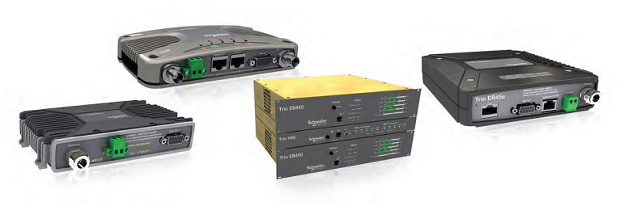
Bringing versatility and reliability to your wireless network
Trio Data Radios
Wireless communication for telemetry and remote SCADA solutions
Stefan, klick on logo to continue!

