Slide 1
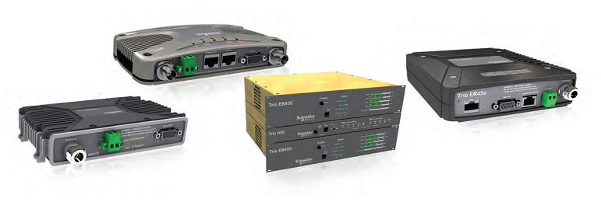


Bringing versatility and reliability to your wireless network
Trio Data Radios
Wireless communication for telemetry and remote SCADA solutions
Stefan, klick on logo to continue!

Slide 2
Vnašamo vsestranskost in zanesljivost v vaše brezžično omrežje
Trio Data Radios
Brezžična komunikacija za telemetrijo in daljinsko vodenje
Stefan, klick on logo to continue!

